Slide 1

Introduction/Overview
Modern Information Retrieval by Ricardo Baeza - Yates and Berthier Ribeiro- Neto

Slide 2

IR: representation, storage, organization of, and access to information items
Focus is on the user information need
User information need:
  Find all docs containing information on college tennis teams which: (1) are maintained by a USA university and (2) participate in the NCAA tournament.
Emphasis is on the retrieval of information (not data)

Slide 3

Records (tuples) vs. documents
Well defined results vs. fuzzy results
DB grew out of files and traditional business systems
IR grew out of library science and need to categorize/group/access books/articles

Slide 4
DB vs IR (cont’d)
Data retrieval
  which docs contain a set of keywords?
  Well defined semantics
  a single erroneous object implies failure!
Information retrieval
  information about a subject or topic
  semantics is frequently loose
  small errors are tolerated
IR system:
  interpret contents of information items
  generate a ranking which reflects relevance
  notion of relevance is most important

Slide 5
Motivation
IR in the last 20 years:
  classification and categorization
  systems architecture and languages
  user interfaces and visualization
Still, area was seen as of narrow interest
Advent of the Web changed this perception once and for all
  universal repository of knowledge
  free (low cost) universal access
  no central editorial board
  and so on:
  IR seen as key to finding the solutions!

Slide 6
Basic Concepts
The User Task
  Retrieval
    information or data
    purposeful
  Browsing
    glancing around
    cars, Le Mans, France, tourism
Retrieval
Database
Browsing

Slide 7
Basic Concepts
Logical view of the documents
Document representation viewed as a continuum: logical view of docs might shift from a full text representation to a higher level representation
Accents
spacing
Noun
groups
Manual
indexing
Docs
Stopwords
Stemming
Structure
structure
Full text
Index terms

Slide 8
The Retrieval Process
User
Interface
Text
user need
Text
Text Operations
logical view
logical view
Query
Operations
DB Manager
Module
Indexing
user feedback
query
inverted file
Searching
Index
retrieved docs
Text
Database
Ranking
ranked docs

Slide 9
Chapter 2 Modeling

Slide 10
Introduction
Traditional information retrieval systems usually adopt index terms to index and retrieve documents.
An index term is a keyword(or group of related words) which has some meaning of its own (usually a noun).
The advantage of using index terms
Simple
The semantic of the documents and of the user information need can be naturally expressed through sets of index terms.
Ranking algorithms are at the core of information
retrieval systems(predicting which documents are
relevant and which are not).

Slide 11
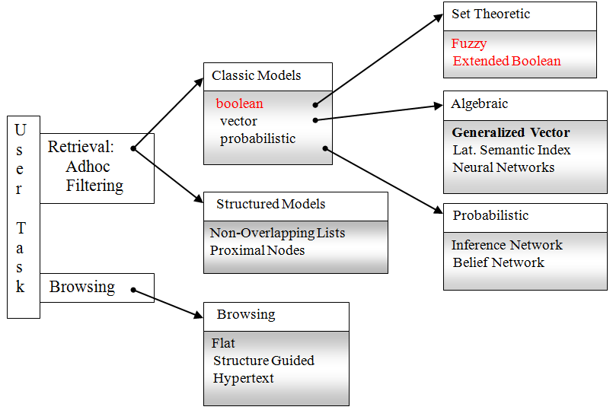
A taxonomy of information retrieval models

Slide 12
Figure Retrieval models most frequently associated with distinct combinations of a document logical view and a user task.
 | Index Terms | Full Text | Full Text+ Structure
Retrieval | Classic Set Theoretic Algebraic Probabilistic | Classic Set Theoretic Algebraic Probabilistic | Structured
Browsing | Flat | Flat Hypertext | Structure Guided Hypertext

Slide 13
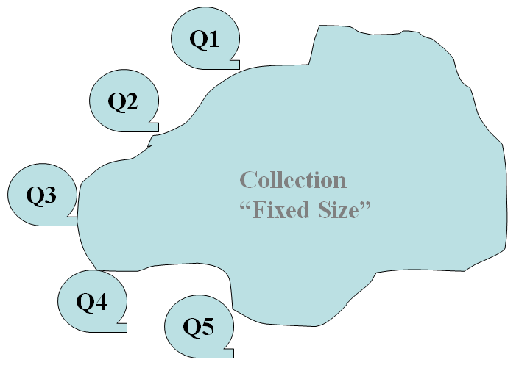
Retrieval : Ad hoc and Filtering
Ad hoc : The documents in the collection remain relatively static while new queries are submitted to the system.
Filtering : The queries remain relatively static while new documents come into the system

Slide 14
Filtering
Typically, the filtering task simply indicates to the user the documents which might be of interest to him.
Routing : Rank the filtering documents and show this ranking to the user.
Constructing user profiles in two ways.

Slide 15
D : A set composed of logical views(or representation) for the documents in the collection.
Q : A set composed of logical views(or representation) for the user information needs(queries).
F : A framework for modeling document representations, queries, and their relationships.
R(q_{i}, d_{j}) : A ranking function which defines an ordering among the documents with regard to the query.

Slide 16

Basic concepts : Each document is described by a set of representative keywords called index terms.
Assign a numerical weights to distinct relevance between index terms.

Slide 17

k_{i} : A generic index term
K : The set of all index terms {k₁,…,k_{t}}
w_{i,j} : A weight associated with index term
k_{i} of a document d_{j}
g_{i} : A function returns the weight associated
with k_{i} in any t-dimensoinal vector( g_{i}(d_{j}) = w_{i,j} )

Slide 18
The Boolean Model
Simple model based on set theory
Queries specified as boolean expressions
  precise semantics
  neat formalism
  q = ka ∧ (kb ∨ ¬kc)
Terms are either present or absent. Thus, wij ε {0, 1}
Consider
  q = ka ∧ (kb ∨ ¬kc)
  vec(qdnf) = (1,1,1) ∨ (1,1,0) ∨ (1,0,0)
Each query can be transformed in DNF form

Slide 19
The Boolean Model
Ka
Kb
q = ka ∧ (kb ∨ ¬kc)
sim(q,dj) = 1, if document satisfies the boolean query
0 otherwise
- no in-between, only 0 or 1
(1,1,0)
(1,0,0)
(1,1,1)
Kc

Slide 20
Drawbacks of the Boolean Model
Retrieval based on binary decision criteria with no notion of partial matching
No ranking of the documents is provided (absence of a grading scale)
Information need has to be translated into a Boolean expression which most users find awkward
The Boolean queries formulated by the users are most often too simplistic
As a consequence, the Boolean model frequently returns either too few or too many documents in response to a user query

Slide 21
The Vector Model

Slide 22
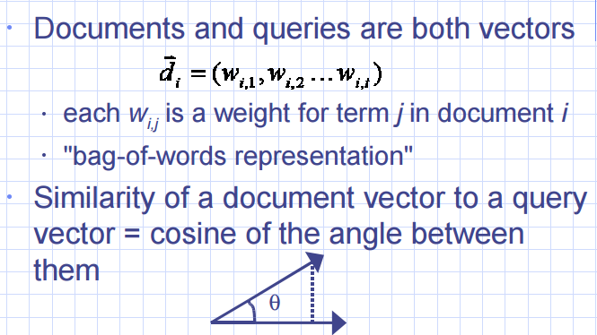
Introduction

Slide 23
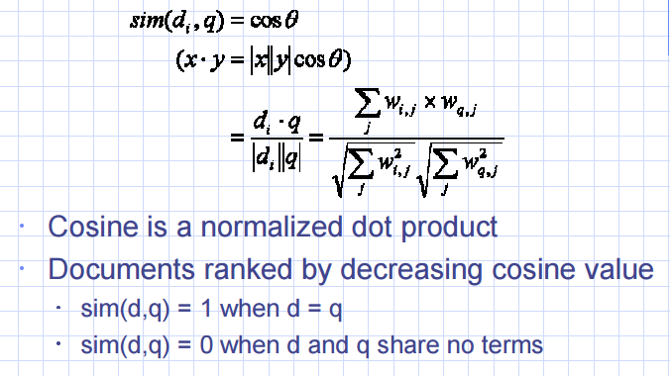
Cosine Similarity Measure

Slide 24
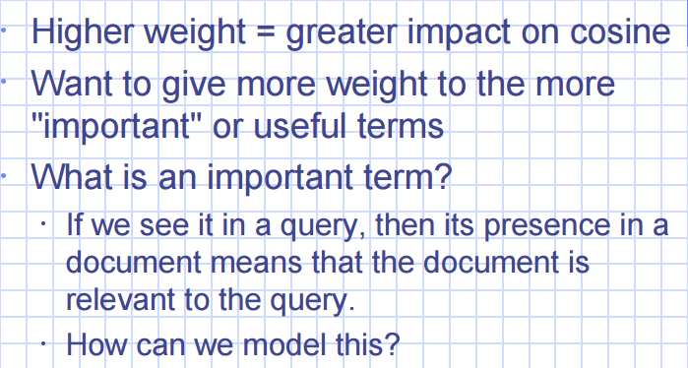
Term Weighting

Slide 25
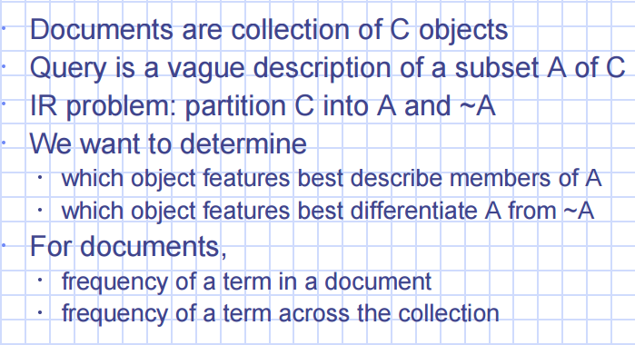
Clustering Analogy

Slide 26
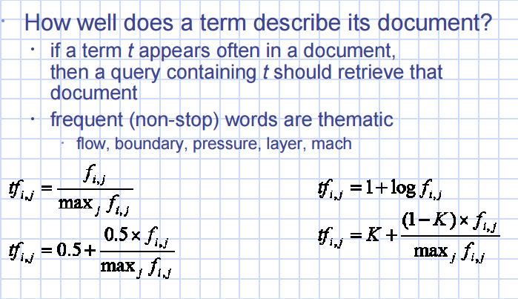
Term Frequency (tf) factor

Slide 27
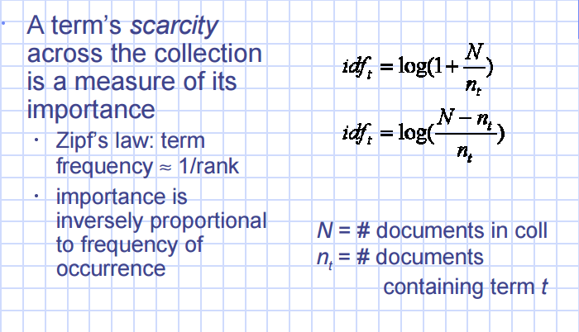
Inverse Document Frequency (idf) factor

Slide 28
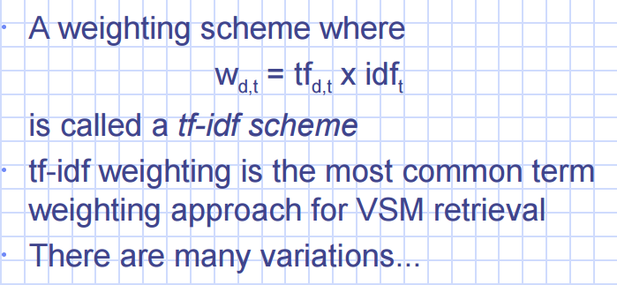
tf-idf weighting

Slide 29
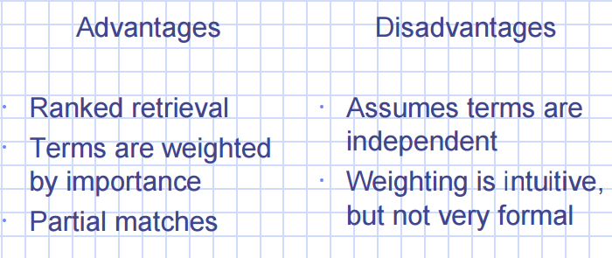
Vector Space Model

Slide 30

Introduced by Roberston and Sparck Jones, 1976
Also called Binary Independence Retrieval (BIR) model
Idea: Given a user query q, and the ideal answer set of the relevant documents, the problem is to specify the properties for this set.
  i.e. the probabilistic model tries to estimate the probability that the user will find the document d_{j} relevant with ratio
  P(d_{j} relevant to q)/P(d_{j} non-relevant to q)

Slide 31




Definition
  All index term weights are all binary i.e., w_{i,j} ∈ {0,1}
  Let R be the set of documents know to be relevant to query q
  Let be the complement of R
  Let be the probability that the document d_{j} is relevant to the query q
  Let be the probability that the document d_{j} is non-relevant to query q

Slide 32

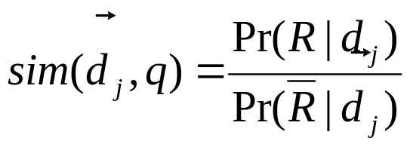
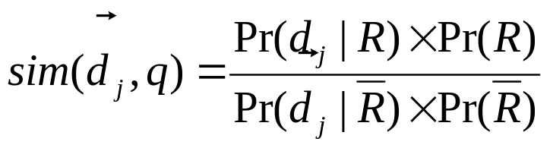

The similarity sim(d_{j},q) of the document d_{j} to the query q is defined as the ratio
Using Bayes’ rule,
  P(R) stands for the probability that a document randomly selected from the entire collection is relevant
  stands for the probability of randomly selecting the document d_{j} from the set R of relevant documents

Slide 33

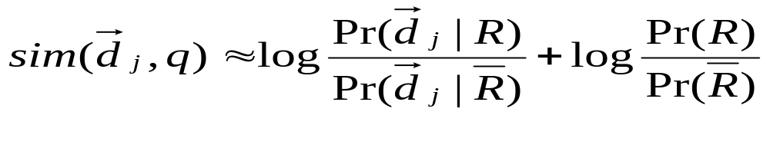
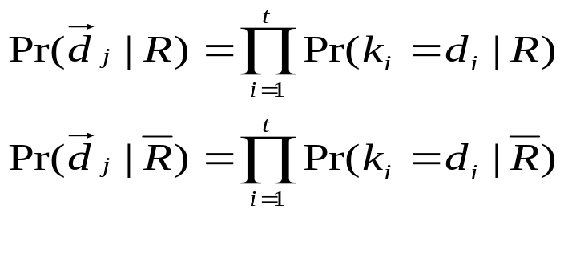
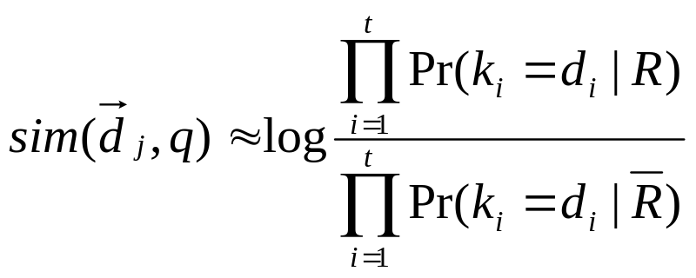
Assuming independence of index terms and given q=(d₁, d₂, …, d_{t}),

Slide 34

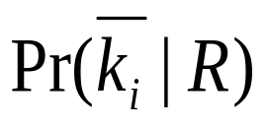
  Pr(k_{i} |R) stands for the probability that the index term k_{i} is present in a document randomly selected from the set R
  stands for the probability that the index term k_{i} is not present in a document randomly selected from the set R

Slide 35

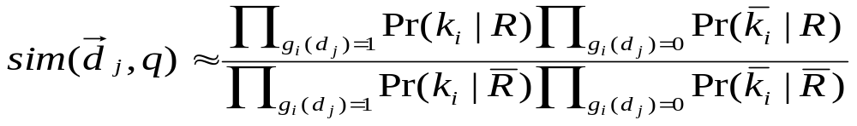
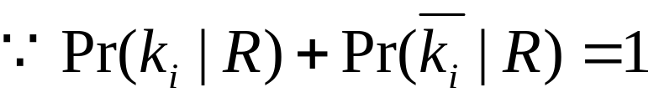
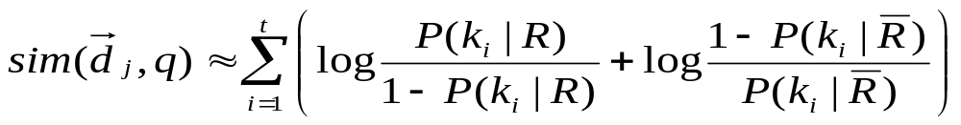
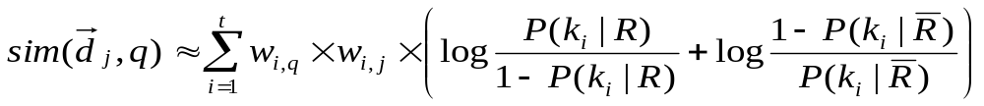

Slide 36

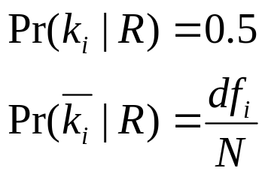
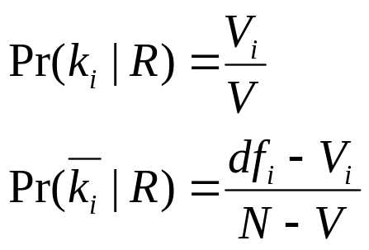
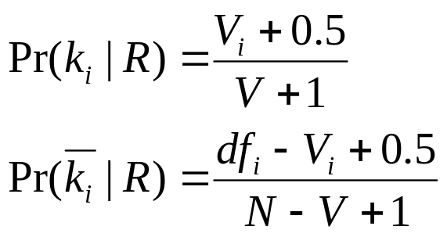
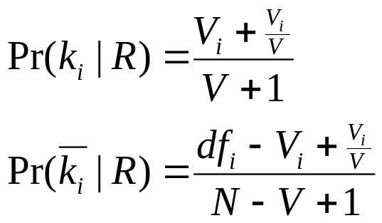
In the very beginning:
Next, the ranking can be improved as follows:
For small values for V
Let V be a subset
of the documents
initially retrieved

Slide 37

Fuzzy Set Model
Extended Boolean Model

Slide 38

The Boolean model imposes a binary criterion for deciding relevance
The question of how to extend the Boolean model to accommodate partial matching, i.e., a ranking for the documents retrieved has attracted considerable attention in the past
We discuss now two set theoretic models for this:
  Fuzzy Set Model
  Extended Boolean Model

Slide 39

Queries and docs represented by sets of index terms:
matching is approximate from the start
This vagueness can be modeled using a fuzzy framework, as follows:
  with each term is associated a fuzzy set
  each doc has a degree of membership in this fuzzy set
This interpretation provides the foundation for many IR models based on fuzzy theory
Here, we discuss the model proposed by Ogawa, Morita, and Kobayashi (1991)

Slide 40

Framework for representing classes whose boundaries are not well defined
Key idea is to introduce the notion of a degree of membership associated with the elements of a set
This degree of membership varies from 0 to 1 and allows modeling the notion of marginal membership
Thus, membership is now a gradual notion, contrary to the crispy notion enforced by classic Boolean logic

Slide 41

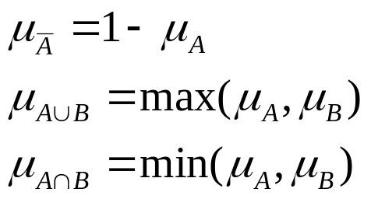
A fuzzy subset A of a universe U is characterized by a membership function u_{A}: U→{0,1} which associates with each element u∈U a number u_{A}
Let A and B be two fuzzy subsets of U,

Slide 42

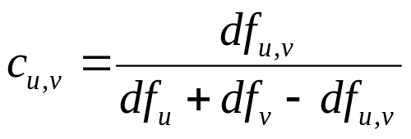
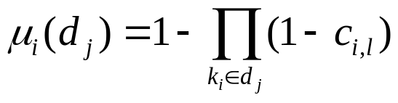


Using a term-term correlation matrix
Define a fuzzy set associated to each index term k_{i}.
  If a term k_{l} is strongly related to k_{i}, that is c_{i,l} ~1, then
  If a term k_{l} is loosely related to k_{i}, that is c_{i,l} ~0, then

Slide 43
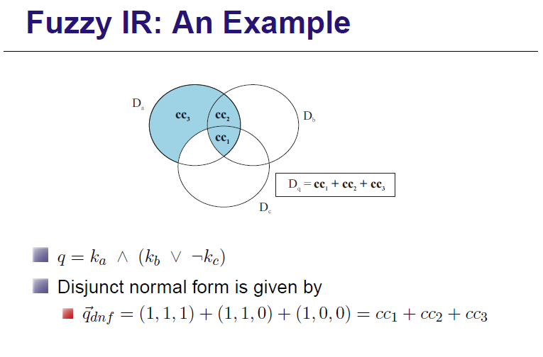

Slide 44
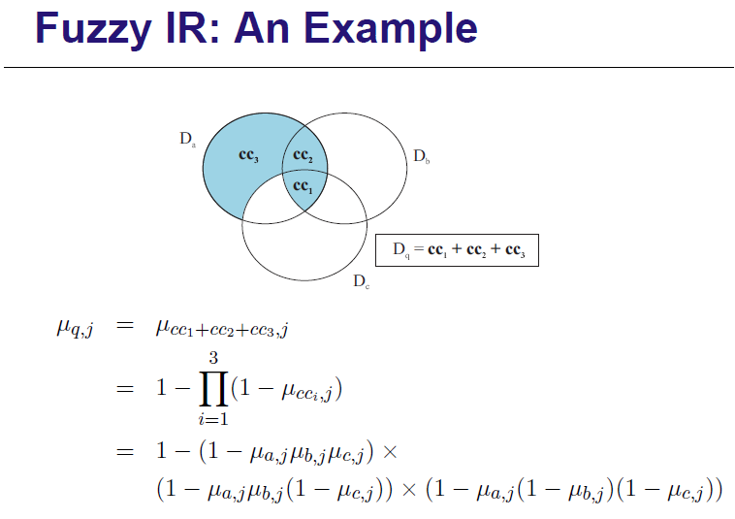

Slide 45
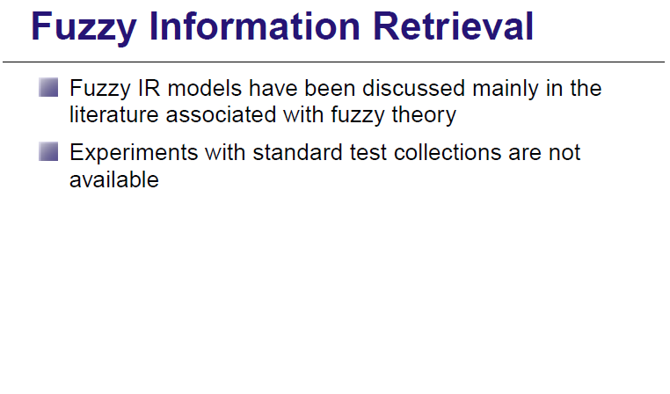

Slide 46


Slide 47

Boolean model is simple and elegant
But, no provision for a ranking
As with the fuzzy model, a ranking can be obtained by relaxing the condition on set membership
Extend the Boolean model with the notions of partial matching and term weighting
Combine characteristics of the Vector model with properties of Boolean algebra

Slide 48
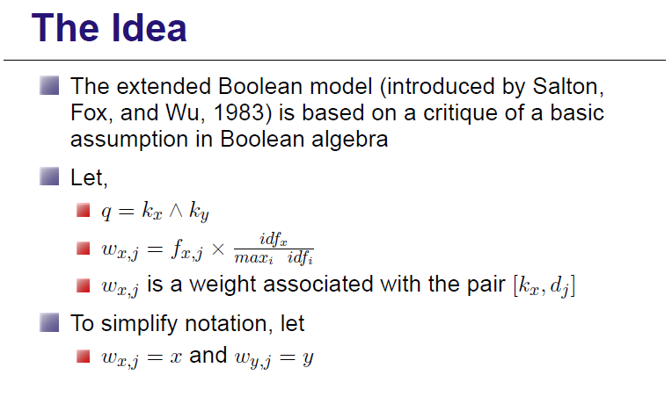

Slide 49
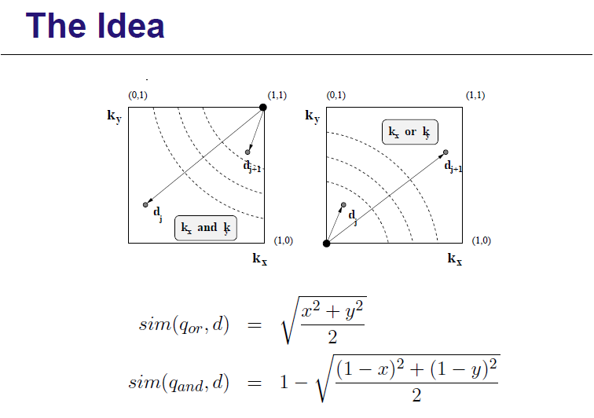

Slide 50
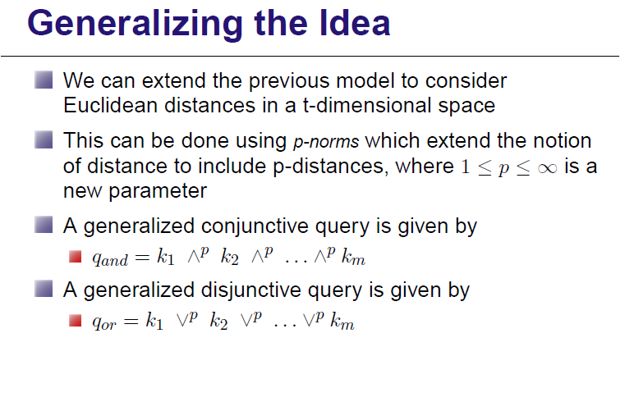

Slide 51
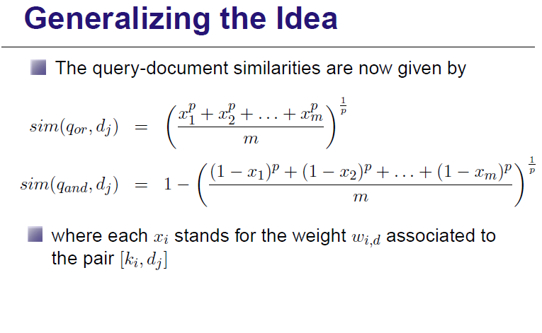

Slide 52
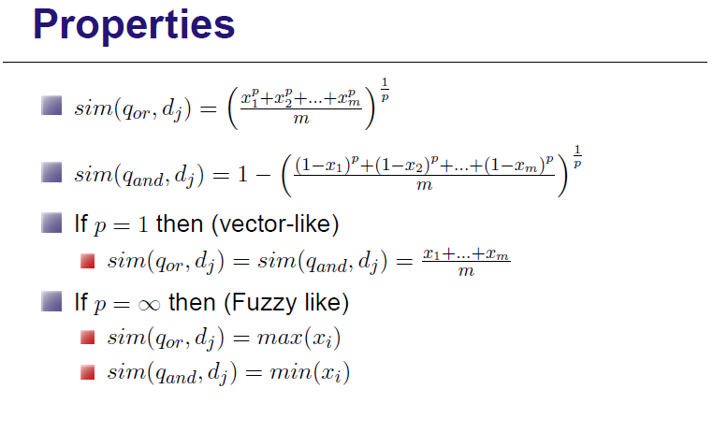

Slide 53
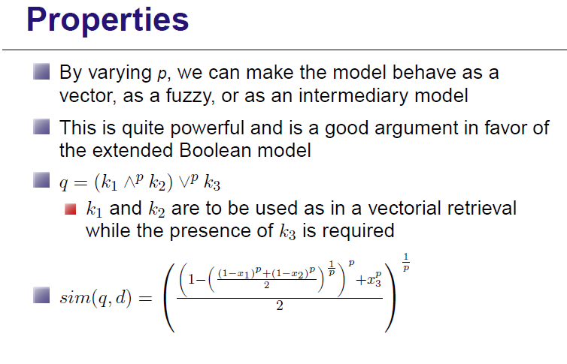

Slide 54
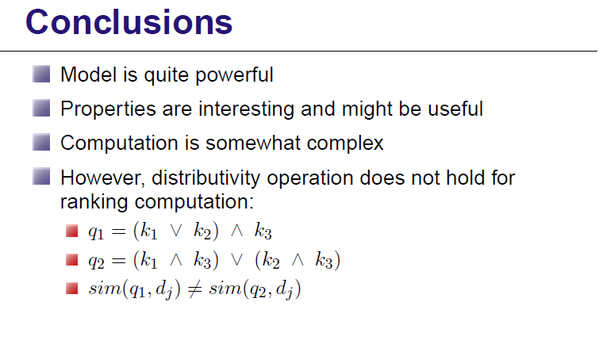

Slide 55

Classic IR:
  Terms are used to index documents and queries
  Retrieval is based on index term matching
Motivation:
  Neural networks are known to be good pattern matchers

Slide 56
Neural Networks:
  The human brain is composed of billions of neurons
  Each neuron can be viewed as a small processing unit
  A neuron is stimulated by input signals and emits output signals in reaction
  A chain reaction of propagating signals is called a spread activation process
  As a result of spread activation, the brain might command the body to take physical reactions

Slide 57
A neural network is an oversimplified representation of the neuron interconnections in the human brain:
  nodes are processing units
  edges are synaptic connections
  the strength of a propagating signal is modelled by a weight assigned to each edge
  the state of a node is defined by its activation level
  depending on its activation level, a node might issue an output signal

Slide 58
Neural Network for IR:
From the work by Wilkinson & Hingston
Query Terms
Document Terms
Documents
k₁
d₁
k_{a}
k_{a}
d_{j}
k_{b}
k_{b}
d_{j+1}
k_{c}
k_{c}
k_{t}
d_{N}

Slide 59
Neural Network for IR
Three layers network
Signals propagate across the network
First level of propagation:
  Query terms issue the first signals
  These signals propagate accross the network to reach the document nodes
Second level of propagation:
  Document nodes might themselves generate new signals which affect the document term nodes
  Document term nodes might respond with new signals of their own

Slide 60
Quantifying Signal Propagation
Normalize signal strength (MAX = 1)
Query terms emit initial signal equal to 1
Weight associated with an edge from a query term node ki to a document term node ki:
  Wiq = wiq sqrt ( Σi wiq )
Weight associated with an edge from a document term node ki to a document node dj:
  Wij = wij sqrt ( Σi wij )
2
2

Slide 61
Quantifying Signal Propagation
After the first level of signal propagation, the activation level of a document node dj is given by: Σi Wiq Wij = Σi wiq wij sqrt ( Σi wiq ) * sqrt ( Σi wij )
    which is exactly the ranking of the Vector model
New signals might be exchanged among document term nodes and document nodes in a process analogous to a feedback cycle
A minimum threshold should be enforced to avoid spurious signal generation
2
2

Slide 62
Conclusion
Model provides an interesting formulation of the IR problem
Model has not been tested extensively
It is not clear the improvements that the model might provide

